Slide 1
EXECUTIVE REPORT | TEMPERATURE FORECAST
Executive Summary
5
Cities forecast
14 days
Forecast horizon
14-DAY TEMPERATURE OUTLOOK BY CITY
City
Avg Forecast Temp
Max Forecast Temp
Min Forecast Temp
Jakarta
28.3°C
33.7°C
24.6°C
Surabaya
28.4°C
31.4°C
24.6°C
Bandung
23.8°C
29.9°C
18.4°C
Medan
26.5°C
31.5°C
23.5°C
Semarang
28.4°C
33.2°C
24.4°C
Model performance (backtest accuracy) is on the last slide of this deck.
LightGBM Direct Multi-Horizon Forecast | 14-Day Outlook
01/07

Slide 2
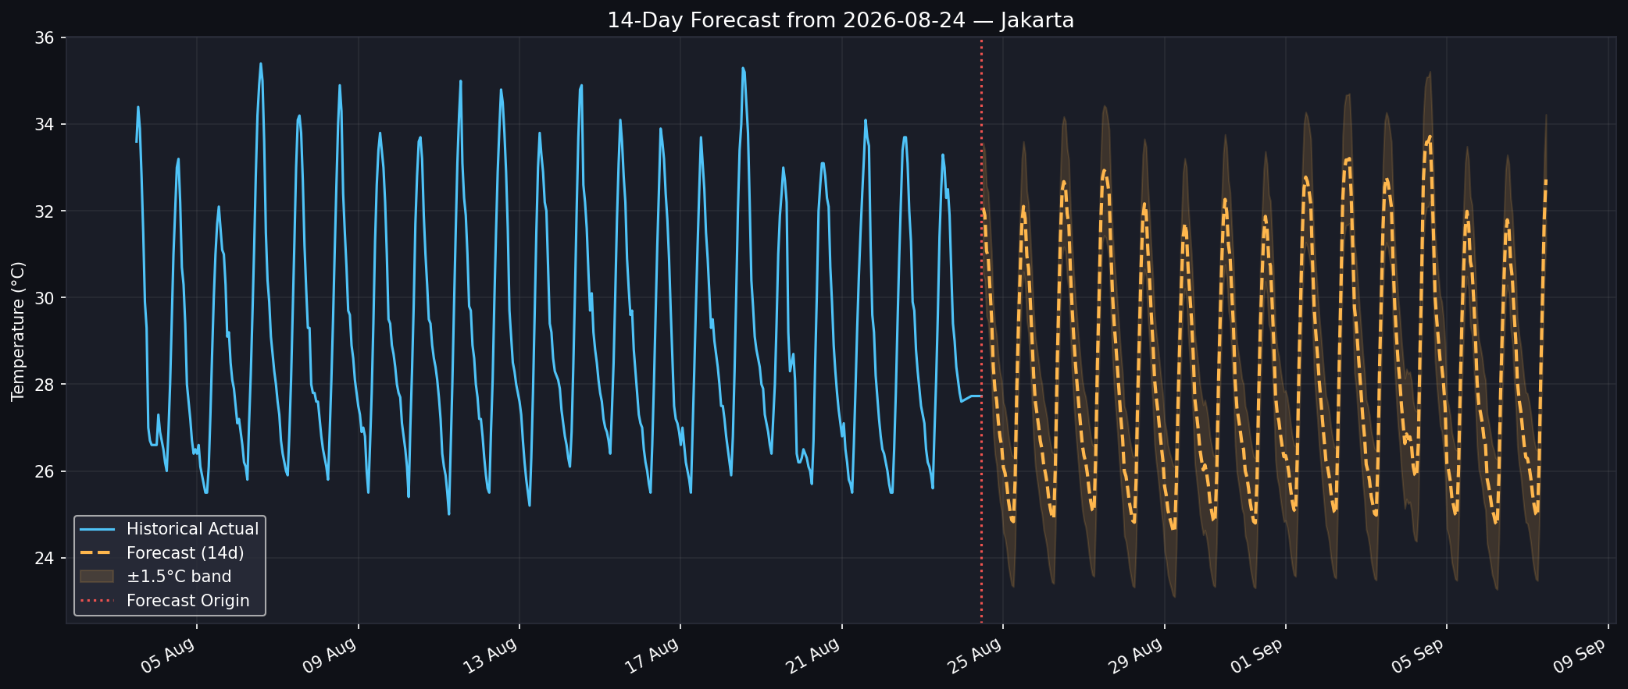
EXECUTIVE REPORT | TEMPERATURE FORECAST
Jakarta -- 14-Day Forecast
LIVE 14-DAY FORECAST FAN
LightGBM Direct Multi-Horizon Forecast | 14-Day Outlook
02/07

Slide 3
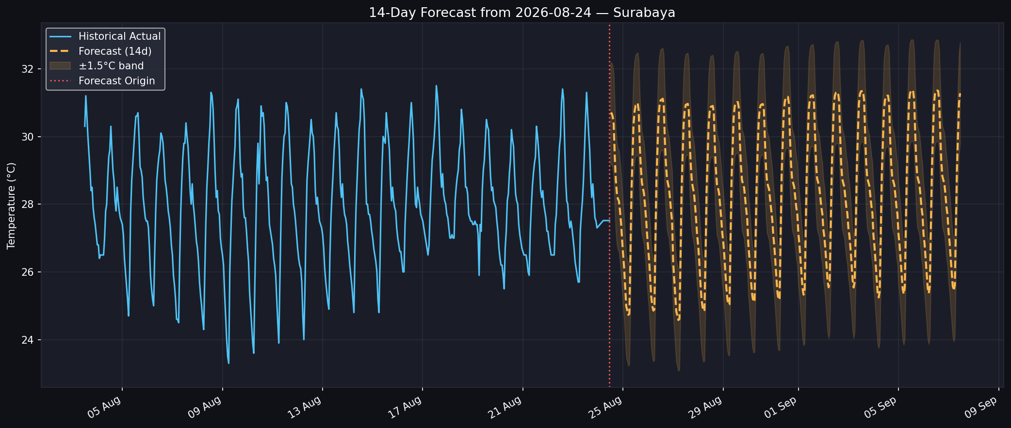
EXECUTIVE REPORT | TEMPERATURE FORECAST
Surabaya -- 14-Day Forecast
LIVE 14-DAY FORECAST FAN
LightGBM Direct Multi-Horizon Forecast | 14-Day Outlook
03/07

Slide 4
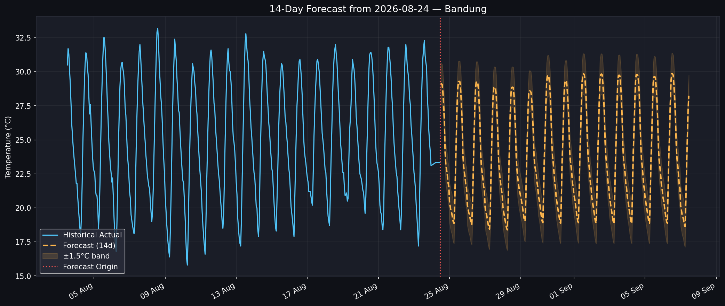
EXECUTIVE REPORT | TEMPERATURE FORECAST
Bandung -- 14-Day Forecast
LIVE 14-DAY FORECAST FAN
LightGBM Direct Multi-Horizon Forecast | 14-Day Outlook
04/07

Slide 5
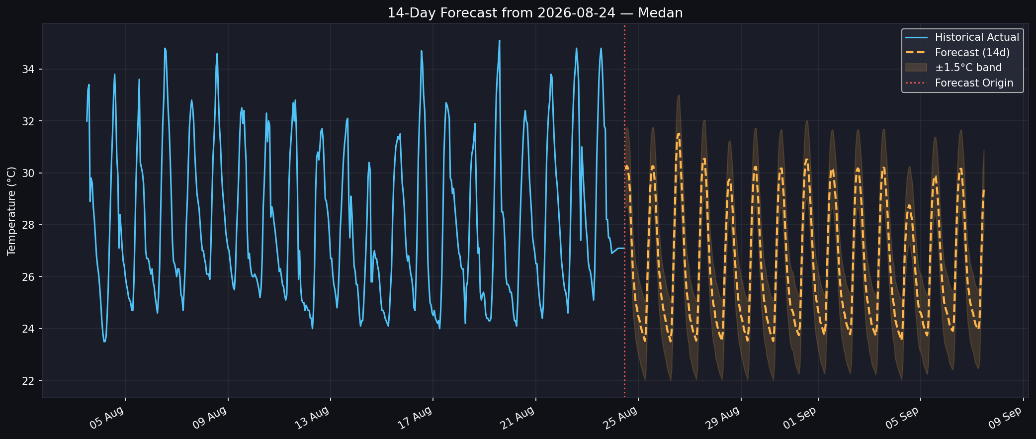
EXECUTIVE REPORT | TEMPERATURE FORECAST
Medan -- 14-Day Forecast
LIVE 14-DAY FORECAST FAN
LightGBM Direct Multi-Horizon Forecast | 14-Day Outlook
05/07

Slide 6
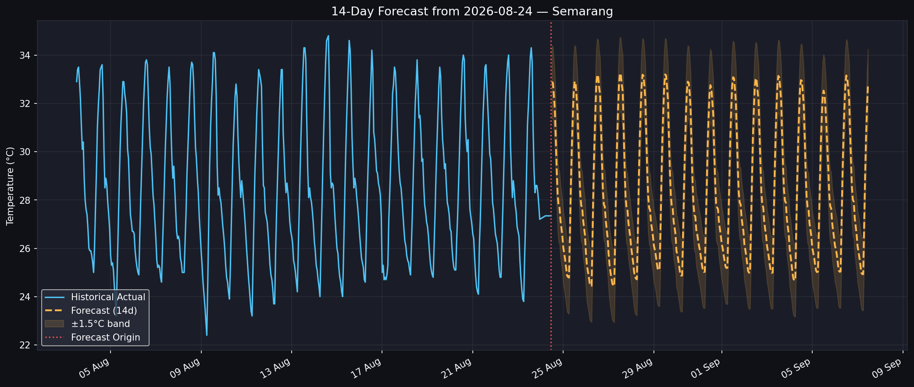
EXECUTIVE REPORT | TEMPERATURE FORECAST
Semarang -- 14-Day Forecast
LIVE 14-DAY FORECAST FAN
LightGBM Direct Multi-Horizon Forecast | 14-Day Outlook
06/07

Slide 7
EXECUTIVE REPORT | TEMPERATURE FORECAST
Model Performance
BACKTEST ACCURACY BY CITY (WALK-FORWARD ROLLBACK TESTING)
City
MAE
RMSE
R-squared
Jakarta
1.63°C
1.89°C
0.53
Surabaya
0.61°C
0.80°C
0.79
Bandung
1.78°C
2.11°C
0.75
Medan
1.48°C
1.85°C
0.54
Semarang
1.02°C
1.28°C
0.82
HEADLINE FINDINGS
Most accurate: Surabaya (0.61°C MAE). Least accurate: Bandung (1.78°C MAE).
Average backtest MAE across all cities: 1.30°C, from many historical origins each forecast 14 days ahead and scored against what actually happened.
LightGBM Direct Multi-Horizon Forecast | 14-Day Outlook
07/07

